Slide 1






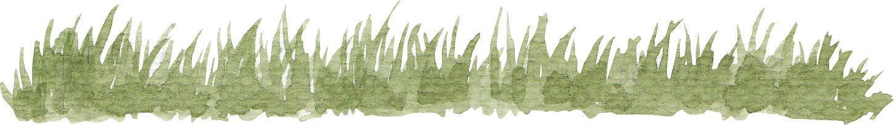
RED-BLACK TREES
Maria Dominique Daculan
Giovanni Ross Sucalit
Maurice Lance Tezon
Simone Rafael Yu

Slide 2
RED-BLACK TREES

Slide 3


WHAT IS A RED-BLACK TREE?
A red-black tree is a self-balancing binary search tree
Each node has an additional data that contains the color of the node, either RED or BLACK
8
6
15
2
12

Slide 4
RED-BLACK TREES
Rudolf Bayer
1972
Originally called Symmetric Binary B-tree
Later renamed to Red-Black Tree by Robert Sedgewick and Leonidas J. Guibas (1978)

Slide 5
WHAT MAKES A RED-BLACK TREE A RED-BLACK TREE?

Slide 6
RED-BLACK TREE PROPERTIES
BLACK PROPERTY
RED PROPERTY
DEPTH PROPERTY

Slide 7

PROPERTIES OF A RED-BLACK TREE
BLACK PROPERTY
The root and the NULL leaves are always black nodes
12
6
18
1
8
24

Slide 8
PROPERTIES OF A RED-BLACK TREE
BLACK PROPERTY
The root and the NULL leaves are always black nodes
12
6
18
1
8
24

Slide 9
PROPERTIES OF A RED-BLACK TREE
RED PROPERTY
Red nodes can only have black nodes as children
8
6
15
2
12

Slide 10
PROPERTIES OF A RED-BLACK TREE
RED PROPERTY
Red nodes can only have black nodes as children
8
6
15
2
12

Slide 11
PROPERTIES OF A RED-BLACK TREE
DEPTH PROPERTY
Every path from any given node to any of its NULL descendants must have the same number of black nodes
11
5
13
3
7
17
2
2

Slide 12
PROPERTIES OF A RED-BLACK TREE
11
5
13
3
7
17
2
2

Slide 13
PROPERTIES OF A RED-BLACK TREE
Start
11
5
13
3
7
17
2
2

Slide 14
PROPERTIES OF A RED-BLACK TREE
Start
11
5
13
3
7
17
2
2
Finish

Slide 15
PROPERTIES OF A RED-BLACK TREE
Start
11
5
13
3
7
17
2
2
Finish
2

Slide 16
PROPERTIES OF A RED-BLACK TREE
Start
11
5
13
3
7
17
2
2
2
Finish

Slide 17
PROPERTIES OF A RED-BLACK TREE
Start
11
5
13
3
7
17
2
2
2
2
Finish

Slide 18
PROPERTIES OF A RED-BLACK TREE
Start
11
5
13
3
7
17
2
2
2
2
Finish

Slide 19
PROPERTIES OF A RED-BLACK TREE
Start
11
5
13
3
7
17
2
2
2
2
2
Finish

Slide 20
PROPERTIES OF A RED-BLACK TREE
Start
11
5
13
3
7
17
2
2
2
2
2
Finish

Slide 21
PROPERTIES OF A RED-BLACK TREE
Start
11
5
13
3
7
17
2
2
2
2
2
2
Finish

Slide 22
PROPERTIES OF A RED-BLACK TREE
Start
11
5
13
3
7
17
2
2
2
2
2
2
Finish

Slide 23
PROPERTIES OF A RED-BLACK TREE
Start
11
5
13
3
7
17
2
2
2
2
2
2
2
Finish

Slide 24
PROPERTIES OF A RED-BLACK TREE
Start
11
5
13
3
7
17
2
2
2
2
2
2
2
Finish

Slide 25
PROPERTIES OF A RED-BLACK TREE
Start
11
5
13
3
7
17
2
2
2
2
2
2
2
2
Finish

Slide 26
PROPERTIES OF A RED-BLACK TREE
Start
11
5
13
3
7
17
2
2
2
2
2
2
2
2
Finish

Slide 27
PROPERTIES OF A RED-BLACK TREE
Start
11
5
13
3
7
17
2
2
2
2
2
2
2
2
2
Finish

Slide 28
PROPERTIES OF A RED-BLACK TREE
Start
11
5
13
3
7
17
2
2
2
2
2
2
2
Finish
2
2

Slide 29
PROPERTIES OF A RED-BLACK TREE
Start
11
5
13
3
7
17
2
2
2
2
2
2
2
2
Finish
2
2

Slide 30
PROPERTIES OF A RED-BLACK TREE
Follows the Depth Property
11
5
13
3
7
17
2
2
2
2
2
2
2
2
2
2

Slide 31
RED-BLACK TREE PROPERTIES
BLACK PROPERTY
The root and the NULL leaves are always black nodes
RED PROPERTY
Red nodes can only have black nodes as children
DEPTH PROPERTY
Every path from any given node to any of its NULL descendants must have the same number of black nodes

Slide 32
RED-BLACK TREE OR NOT?
YES or NO.
If NO, explain why.

Slide 33
RED-BLACK TREE OR NOT?
a.)
6
2
12
2
8

Slide 34
RED-BLACK TREE OR NOT?
a.)
6
2
12
2
8
YES

Slide 35
RED-BLACK TREE OR NOT?
b.)
8
3
13
2
5
21
1

Slide 36
RED-BLACK TREE OR NOT?
b.)
8
3
13
2
5
21
1
YES

Slide 37
RED-BLACK TREE OR NOT?
c.)
8
3
13
2
5
21
1

Slide 38
RED-BLACK TREE OR NOT?
c.)
8
3
13
2
5
21
1
NO, violates red property and depth property

Slide 39
RED-BLACK TREE OR NOT?
d.)
8
3
13
2
5
21
1

Slide 40
RED-BLACK TREE OR NOT?
d.)
8
3
13
2
5
21
1
NO, violates depth property

Slide 41
RED-BLACK TREE OR NOT?
e.)
6
2
12
2
8

Slide 42
RED-BLACK TREE OR NOT?
e.)
6
2
12
2
8
NO, violates black property

Slide 43
RED-BLACK TREE OR NOT?
f.)
1
2
12
2
8

Slide 44
RED-BLACK TREE OR NOT?
f.)
1
2
12
2
8
NO, not a BST

Slide 45
SPACE AND TIME COMPLEXITY
SPACE: O( N)
TIME: O(Log N)
Search
Insert
Delete
N=number of nodes

Slide 46
VARIATIONS
Left-leaning Red Black Tree
Tango Tree

Slide 47
RED-BLACK VS AVL
Less rotations
Less balanced

Slide 48
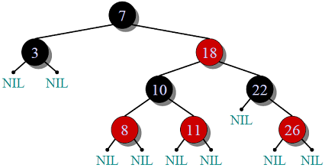
RED-BLACK VS AVL
©Geeks for Geeks

Slide 49
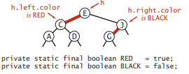
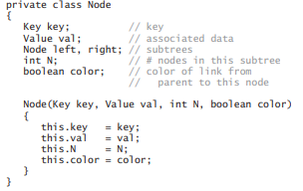
ORIGINAL VERSION
Algorithms 4th Edition, Sedgewick

Slide 50


RBT - STRUCTURE
root
NIL
parent
left
elem
right
rbt-tree
after initialization of RBT
null
color
rbt-node, *ptr
null
0
null
BLACK

Slide 51

RBT - FAMILY TREE
Z = 13
grandparent of Z
8
parent of Z
6
15
uncle of Z
sibling of Z
2
Z

Slide 52
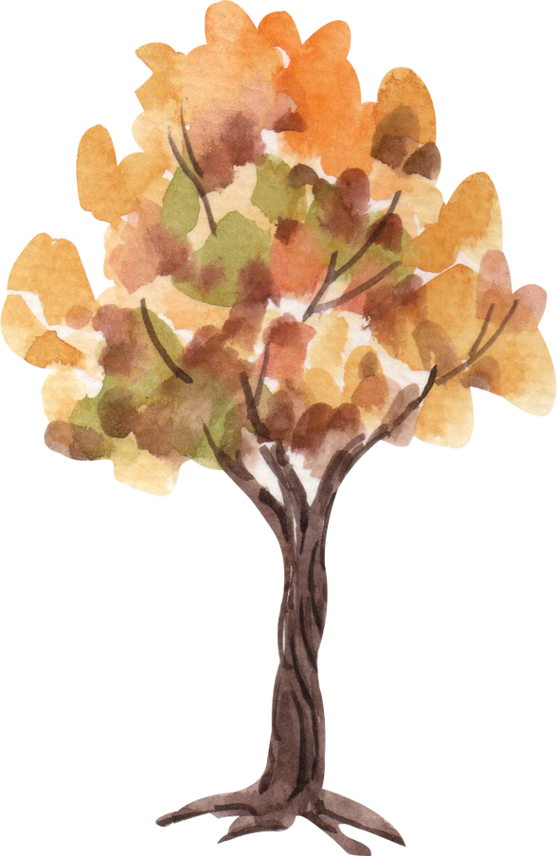
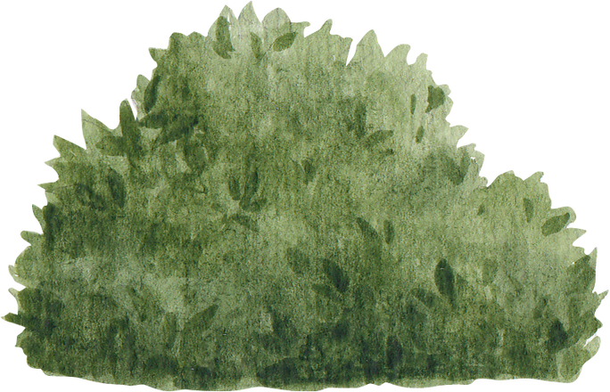

RBT - THE MAKING (RULES)
NEW nodes starts as RED
all NULL nodes are BLACK (how?)
have a NIL node with elem=0, color=BLACK, Left=Right=NULL, to act as the "null" node
ROOT is always BLACK
no CONSECUTIVE REDS

Slide 53
RBT - THE MAKING
let new node be Z
if Z is ROOT, recolour as BLACK
else, check colour of Z-parent:
NO ACTION if Z-parent colour is BLACK
if RED, check colour of Z-uncle
if Z-uncle colour is RED, recolour Z-parent and Z-uncle to BLACK, recolour Z-grandparent to RED
if Z-uncle colour is BLACK, check the family tree for ROTATIONS (4 possible rotation scenarios)

Slide 54
RBT - ROTATION SCENARIOS
LEFT-LEFT CASE
Z-parent is Left-child of Z-grandparent and Z is Left-child of Z-parent
LEFT-RIGHT CASE
Z-parent is Left-child of Z-grandparent and Z is Right-child of Z-parent
RIGHT-RIGHT CASE
Z-parent is Right-child of Z-grandparent and Z is Right-child of Z-parent
RIGHT-LEFT CASE
Z-parent is Right-child of Z-grandparent and Z is Left-child of Z-parent

Slide 55
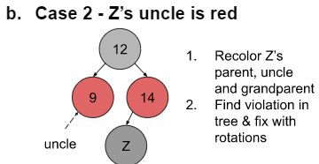
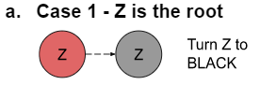
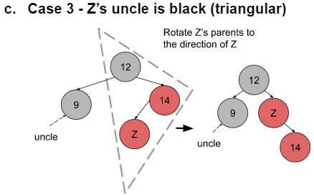
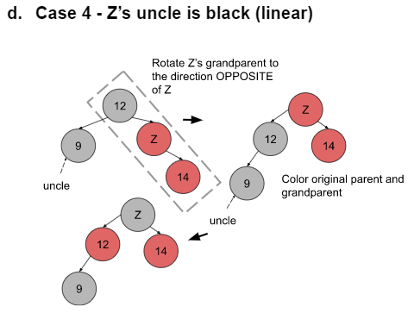
RBT - INSERTION CASES

Slide 56
RBT - THE MAKING
initialize RBT tree as R (as shown in the structure slide)
root
NIL

Slide 57
RBT - THE MAKING
root
NIL
inserting Z -->
2
color it initially RED

Slide 58
RBT - THE MAKING
root
NIL
Z -->
2
do a normal BST insertion through "root"
let the Left and Right child of Z point to NIL (black square)

Slide 59
RBT - THE MAKING
root
NIL
Z -->
2
NIL
let the Left and Right child of Z point to NIL (black square)
this is for illustration purposes only. all NULL nodes point to the same NIL node

Slide 60
RBT - THE MAKING
root
NIL
Z -->
2
NIL
since Z is the ROOT, change color to BLACK

Slide 61
RBT - THE MAKING
root
NIL
inserting Z -->
1
2
NIL
color it initially RED

Slide 62
RBT - THE MAKING
do a normal BST insertion through "root"
root
NIL
2
NIL
1 < 2, so proceed to LEFT SUBTREE
Z -->
1

Slide 63
RBT - THE MAKING
root
NIL
2
NIL
1 < 2, so proceed to LEFT SUBTREE
Z -->
1
no violation, PROCEED with next

Slide 64
RBT - THE MAKING
do a normal BST insertion through "root"
root
NIL
insert Z -->
4
color it initially RED
2
NIL
1

Slide 65
RBT - THE MAKING
root
NIL
2
NIL
4 > 2, go to RIGHT SUB TREE,
1
4
<-- Z
no violations, proceed with next insert

Slide 66
RBT - THE MAKING
do a normal BST insertion through "root"
root
NIL
insert Z -->
6
2
NIL
color it initially RED
1
4

Slide 67
RBT - THE MAKING
root
NIL
2
NIL
6 > 2, go right sub tree
6 > 4, go right sub tree
1
4
6
<-- Z

Slide 68
RBT - THE MAKING
root
NIL
VIOLATION!!!!!
Z and Z-Parent are both RED
Z-uncle is also RED
2
NIL
<-- Z-parent
Z-uncle -->
1
4
6
<-- Z

Slide 69
RBT - THE MAKING
NIL
root
NIL
make Z-grandparent RED
make Z-uncle and Z-parent to BLACK
2
<-- Z-grandparent
<-- Z-parent
Z-uncle -->
1
4
6
<-- Z

Slide 70
RBT - THE MAKING
NIL
VIOLATION!!
root node is RED
root
NIL
2
<-- Z-grandparent
<-- Z-parent
Z-uncle -->
1
4
6
<-- Z

Slide 71
RBT - THE MAKING
NIL
root
NIL
make root node BLACK
2
<-- Z-grandparent
<-- Z-parent
Z-uncle -->
1
4
6
<-- Z

Slide 72
RBT - THE MAKING
do a normal BST insertion through "root"
NIL
root
NIL
insert Z -->
5
2
1
4
6

Slide 73
RBT - THE MAKING
NIL
root
NIL
5 > 2, go RSubtree
5 > 4, go RSubtree
5 < 6, go LSubtree
2
1
4
6
Z -->
5

Slide 74
RBT - THE MAKING
NIL
Z-parent is RED
Z-uncle is BLACK (NIL node)
root
NIL
Z-parent is Right-child of Z-grandparent
and Z is Left-child of Z-parent (triangle)
2
1
4
<-- Z-grandparent
6
<-- Z-parent
Z-uncle -->
Z -->
5

Slide 75
RBT - THE MAKING
NIL
root
NIL
let Z be its parent
do a RIGHT-LEFT rotation with Z
2
<-- Z-grandparent
Z-uncle -->
1
4
<-- Z-parent
6
<-- Z
5

Slide 76
RBT - THE MAKING - RIGHT ROTATION
let a pointer (this case, y) points to the node we want to rotate (this case, left-child of Z)
root
NIL
NIL
2
<-- Z-grandparent
Z-uncle -->
1
4
<-- Z-parent
6
<-- Z and y-parent
5

Slide 77

RBT - THE MAKING - RIGHT ROTATION
root
NIL
NIL
2
<-- Z-grandparent
Z-uncle -->
1
4
<-- Z-parent
6
<-- Z and y-parent
y
5

Slide 78
RBT - THE MAKING - RIGHT ROTATION
Z-LeftChild gets the Right-child of y
root
NIL
NIL
2
<-- Z-grandparent
Z-uncle -->
1
4
<-- Z-parent
6
<-- Z and y-parent
y
5

Slide 79
RBT - THE MAKING - RIGHT ROTATION
root
NIL
NIL
2
<-- Z-grandparent
Z-uncle -->
1
4
<-- Z-parent
6
<-- Z and y-parent
y
5

Slide 80
RBT - THE MAKING - RIGHT ROTATION
if y-right is a NON-NULL child, then y-right-parent gets Z
root
NIL
NIL
2
<-- Z-grandparent
Z-uncle -->
1
4
<-- Z-parent
6
<-- Z and y-parent
y
5
in this case, y-right is NIL, then nothing happens

Slide 81
RBT - THE MAKING - RIGHT ROTATION
y-parent points to the Z-parent
root
NIL
NIL
2
<-- Z-grandparent
Z-uncle -->
1
4
<-- Z-parent and y-parent
6
<-- Z
y
5

Slide 82
RBT - THE MAKING - RIGHT ROTATION
if Z->parent points to NIL, root points to Y.
else if Z is the Right-child, let Z-parent-RightChild point to Y.
else, let Z-parent-LeftChild point to Y.
root
NIL
NIL
2
<-- Z-grandparent
Z-uncle -->
1
4
<-- Z-parent and y-parent
6
<-- Z
y
5

Slide 83
RBT - THE MAKING - RIGHT ROTATION
root
NIL
NIL
2
<-- Z-grandparent
Z-uncle -->
1
4
<-- Z-parent and y-parent
6
<-- Z
y
5

Slide 84
RBT - THE MAKING - RIGHT ROTATION
let Y-RightChild point to Z
Z-parent point to Y
root
NIL
NIL
2
<-- Z-grandparent
Z-uncle -->
1
4
<-- Z-parent and y-parent
6
<-- Z
y
5

Slide 85
RBT - THE MAKING - RIGHT ROTATION
root
NIL
NIL
2
1
4
<-- y-parent and Z-grandparent
Z-uncle -->
<-- Z-parent
5
y
6
<-- Z

Slide 86
RBT - THE MAKING - RIGHT ROTATION
recolour Z-parent to BLACK, and Z-grandparent to RED
root
NIL
NIL
2
1
4
<-- y-parent and Z-grandparent
Z-uncle -->
<-- Z-parent
5
y
6
<-- Z

Slide 87
RBT - THE MAKING - RIGHT ROTATION
root
NIL
NIL
2
1
4
<-- Z-grandparent
Z-uncle -->
<-- Z-parent
5
6
<-- Z
Y disappears as we have finished with the RIGHT rotation

Slide 88
RBT - THE MAKING - LEFT ROTATION
let a pointer (this case, Y) points to the node we want to rotate (this case, right-child of Z)
root
NIL
NIL
2
<-- Z-parent
<-- Z and Y-parent
1
4
y
5
6

Slide 89
RBT - THE MAKING - LEFT ROTATION
let Z-RightChild point to Y-LeftChild
root
NIL
NIL
2
<-- Z-parent
<-- Z and Y-parent
1
4
y
5
6

Slide 90
RBT - THE MAKING - LEFT ROTATION
root
NIL
NIL
2
<-- Z-parent
<-- Z and Y-parent
1
4
y
5
6

Slide 91
RBT - THE MAKING - LEFT ROTATION
if y-right is a NON-NULL child, then Y-right-parent gets Z, else do nothing
root
NIL
NIL
2
<-- Z-parent
<-- Z and Y-parent
1
4
y
5
6

Slide 92
RBT - THE MAKING - LEFT ROTATION
root
NIL
NIL
2
<-- Z-parent
<-- Z, Y-parent and Y-right-parent
1
4
y
5
6

Slide 93
RBT - THE MAKING - LEFT ROTATION
let Y-parent points to Z-parent
root
NIL
NIL
2
<-- Z-parent
<-- Z, Y-parent and Y-right-parent
1
4
y
5
6

Slide 94
RBT - THE MAKING - LEFT ROTATION
root
NIL
NIL
2
<-- Z-parent and Y-parent
1
<-- Z and Y-right-parent
4
y
5
6

Slide 95
RBT - THE MAKING - LEFT ROTATION
if Z-parent points to NIL, let root be Y
else if Z is the RIGHT child, let Z-parent-right point to Y
else, let Z-parent-left point to Y
root
NIL
NIL
2
<-- Z-parent and Y-parent
1
<-- Z and Y-right-parent
4
y
5
here, Z is a RIGHT child, so it gets Y
6

Slide 96
RBT - THE MAKING - LEFT ROTATION
root
NIL
NIL
2
<-- Z-parent and Y-parent
1
y
4
5
Z and Y-right-parent -->
6

Slide 97
RBT - THE MAKING - LEFT ROTATION
Y-Left points to Z
Y-Right->parent points to Y
root
NIL
NIL
2
<-- Z-parent and Y-parent
1
y
4
5
Z and Y-right-parent -->
6

Slide 98
RBT - THE MAKING - LEFT ROTATION
root
NIL
NIL
2
<-- Y-parent
1
y
5
Z -->
4
6

Slide 99
CHECKING OF UNDERSTANDING
20
27
10
30
25
VIOLATIONS?
ROTATIONS??
FINAL TREE LOOK???

Slide 100
20
UNCLE IS BLACK (NIL)
PARENT IS LC OF GRANDPARENT,
NEW NODE IS RC OF PARENT
DO
LEFT - RIGHT ROTATION
10
30
25
27

Slide 101
20
10
30
AFTER LEFT ROTATION
27
25
Notes:
node to be rotated - 25

Slide 102
20
10
27
AFTER RIGHT ROTATION
25
30
Notes:
node to be rotated - 30

Slide 103
20
10
27
NO MORE VIOLATIONS
25
30
Notes:
node to be rotated - 30

Slide 104

RBT - DELETION
1.) Deleting any black node that has at least one child, as well as any red node.
2.) Deleting a black node without any internal children. This creates a double black. The process requires restructuring/recoloring.

Slide 105
RBT - DELETION
1.) case 1:
-Let p be the node to be deleted
-If p has one internal child, we delete p and
promote the child. The promoted child is
colored black, if p was black.
-else we delete p and promote one of its
external nodes.

Slide 106


RBT - DELETION
p
11
Delete 11
15
15
11

Slide 107

RBT - DELETION
11
Delete 15
11
p
15

Slide 108
RBT - DELETION
1.) case 2:
-Let p be the node to be deleted
-p has two children
-find the inorder predecessor of the node at p
-interchange the entries of p and r, and
delete the node at r.

Slide 109


RBT - DELETION
11
p
p
7
r
r
7
15
11
15
Delete 11
5
5

Slide 110
RBT - DELETION
7
7
5
15
5
15

Slide 111
RBT - DELETION
2.) case 1:
-sibling of p is black and has a red child
-let p be a double black
-let y be the sibling, x be the sibling's child, and
z be the sibling's parent
-relabel x, y, z to a, b, c
-Replace the original z with b. then make a
and c its children
-color a, c and p black, and color b the former
color of z

Slide 112

RBT - DELETION
z
c
11
11
y
p
p
7
b
7
x
5
a
5
Relabel nodes x, y, and z to a, b, and c

Slide 113
RBT - DELETION
c
11
b
7
b
7
p
a
5
11
c
a
5
p
Replace the original z with b. then make a and c its children

Slide 114

RBT - DELETION
b
7
color a, c, and p black and b the former color of z
a
5
11
c
p

Slide 115
RBT - DELETION
2.) case 2:
-sibling of p is black and has a black child
-let p be a double black
-let y be the sibling and z be the sibling's
parent
-color p black and y to red
-if z is red, we change it to black
-else if z is not the root, we color z double
black and we repeat resolving for z

Slide 116
RBT - DELETION
....
color p black and y to red
....
if z is red, we change it to black
....
z
z
z
11
11
11
y
p
p
p
7
y
7
y
7

Slide 117
RBT - DELETION
....
color p black and y to red
if z is not the root, we color z double black
....
z
11
z
11
y
p
p
7
y
7

Slide 118
RBT - DELETION
2.) case 3:
-sibling of p is red
-let p be a double black node
-let y be the sibling and z be the sibling's parent
-rotate around y and z. y becomes the parent
of z
-color y black and z red, then keep resolving
for p

Slide 119
RBT - DELETION
....
z
11
y
p
7
15
....
....
....
....

Slide 120
RBT - DELETION
....
....
y
y
7
7
....
z
....
z
11
11
....
p
....
p
15
15
....
....
....
....

Slide 121
RBT - DELETION
42
Delete 5
10
64
7
29
50
83
5
31

Slide 122
RBT - DELETION
42
Delete 5
10
64
Instance 1
case 1
7
29
50
83
p
5
31

Slide 123
RBT - DELETION
42
Delete 5
10
64
7
29
50
83
31

Slide 124
RBT - DELETION
42
Delete 10
10
64
7
29
50
83
31

Slide 125

RBT - DELETION
42
Delete 10
p
10
64
Instance 1
case 2
r
7
29
50
83
31

Slide 126
RBT - DELETION
42
Delete 10
p
7
64
r
10
29
50
83
31

Slide 127
RBT - DELETION
42
Delete 10
7
64
Instance 2
case 1
p
29
50
83
31

Slide 128
RBT - DELETION
42
Delete 10
z
7
64
p
29
y
50
83
let y be the sibling, x be the sibling's child, and z be the sibling's parent
x
31

Slide 129
RBT - DELETION
42
Delete 10
z
7
64
p
29
y
50
83
x
relabel x, y, z to a, b, c
31

Slide 130
RBT - DELETION
42
Delete 10
c
7
64
p
29
b
50
83
a
31

Slide 131
RBT - DELETION
42
Delete 10
c
7
64
p
29
b
50
83
Replace the original z with b. then make a and c its children
a
31

Slide 132
RBT - DELETION
42
Delete 10
b
29
64
c
a
7
31
50
83
p

Slide 133
RBT - DELETION
42
Delete 10
b
29
64
c
a
7
31
50
83
p
color a, c and p black, and color b the former color of z

Slide 134
RBT - DELETION
42
Delete 10
b
29
64
c
a
7
31
50
83
p

Slide 135
RBT - DELETION
42
Delete 31
29
64
Instance 2
case 2
7
31
50
83

Slide 136
RBT - DELETION
42
Delete 31
z
29
64
y
p
50
83
7
let y be the sibling and z be the sibling's parent

Slide 137
RBT - DELETION
42
Delete 31
z
29
64
y
p
50
83
7
color p black and y to red

Slide 138
RBT - DELETION
42
Delete 31
z
29
64
y
p
50
83
7

Slide 139
RBT - DELETION
42
Delete 31
z
29
64
y
p
50
83
7
if z is red, we change it to black

Slide 140
RBT - DELETION
42
Delete 31
z
29
64
y
p
50
83
7

Slide 141
RBT - DELETION
42
Delete 7
29
64
p
7
50
83

Slide 142
RBT - DELETION
42
Delete 7
29
64
p
7
50
83

Slide 143
RBT - DELETION
42
Delete 7
29
64
50
83

Slide 144
RBT - DELETION
42
Delete 29
29
64
Instance 2
case 3
50
83

Slide 145
RBT - DELETION
z
42
Delete 29
p
y
64
let y be the sibling and z be the sibling's parent
50
83

Slide 146
RBT - DELETION
z
42
Delete 29
p
y
64
rotate around y and z. y becomes the parent of z
50
83

Slide 147
RBT - DELETION
y
64
Delete 29
z
42
83
p
50

Slide 148
RBT - DELETION
y
64
Delete 29
z
42
83
p
50
color y black and z red, then keep resolving for p

Slide 149
RBT - DELETION
y
64
Delete 29
z
42
83
p
50

Slide 150
RBT - DELETION
y
64
Delete 29
z
42
83
p
50
Instance 2
case 2

Slide 151
RBT - DELETION
64
Delete 29
z
42
83
p
y
50
let y be the sibling and z be the sibling's parent

Slide 152
RBT - DELETION
64
Delete 29
z
42
83
p
y
50
color p black and y to red

Slide 153
RBT - DELETION
64
Delete 29
z
42
83
p
y
50

Slide 154
RBT - DELETION
64
Delete 29
z
42
83
p
y
50
if z is red, we change it to black

Slide 155
RBT - DELETION
64
Delete 29
z
42
83
p
y
50

Slide 156
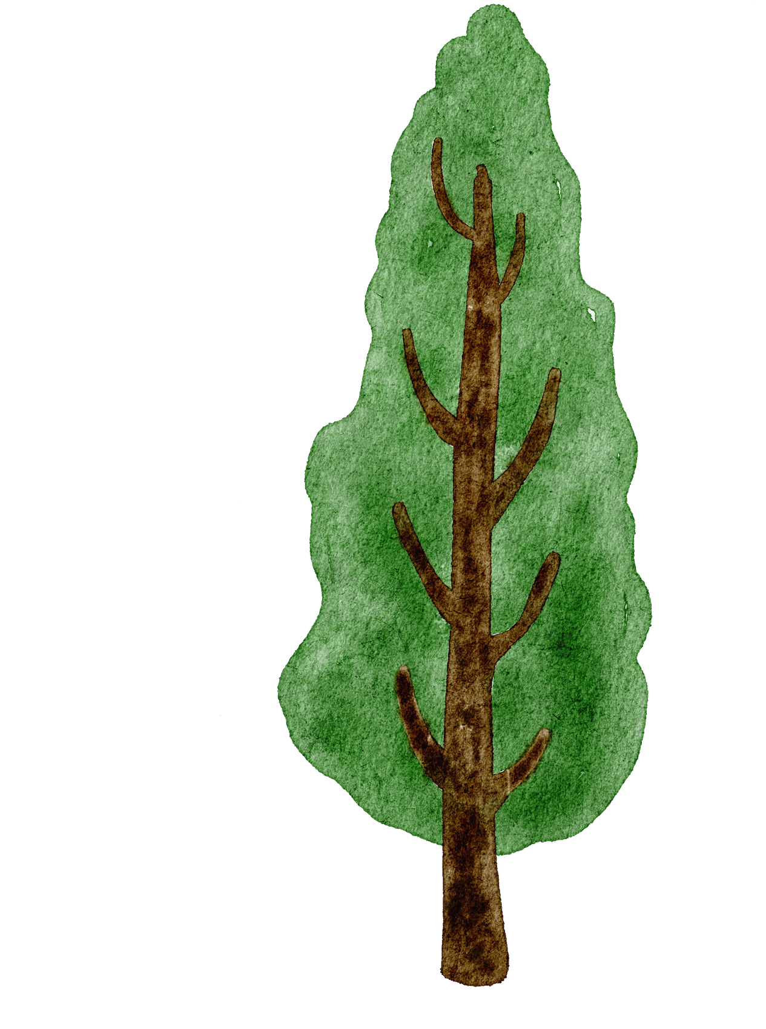



Slide 157








INTERNET CODE
AND
STREAMLINE CODE

Slide 158
INTERNET CODE
STREAMLINE CODE
// Structure to represent each node in a red-black tree
struct node {
int d; // data
int c; // 1-red, 0-black
struct node* p; // parent
struct node* r; // right-child
struct node* l; // left child
};
// global root for the entire tree
struct node* root = NULL;
typedef enum{
red, black
}COLORS;
typedef struct link{
struct link* parent;
struct link* left;
struct link* right;
COLORS color;
int elem;
}node, *ptr;
typedef struct{
ptr root;
ptr NIL;
}RBT;

Slide 159
INTERNET CODE
STREAMLINE CODE
// function to perform BST insertion of a node
struct node* bst(struct node* trav,
struct node* temp)
{
// If the tree is empty,
// return a new node
if (trav == NULL){
return temp;
}
// Otherwise recur down the tree
if (temp->d < trav->d)
{
trav->l = bst(trav->l, temp);
trav->l->p = trav;
}
else if (temp->d > trav->d)
{
trav->r = bst(trav->r, temp);
trav->r->p = trav;
}
return trav;
}
void insert(RBT *R, ptr newNode){
// should point to parent of node to insert
ptr y = R->NIL;
ptr temp = R->root;
while(temp != R->NIL){
y = temp;
printf("temp->elem: %2d < newNode->elem: %2d\n\n", temp->elem, newNode->elem);
if(temp->elem < newNode->elem){
temp = temp->right;
}else{
temp = temp->left;
}
}
puts("----- POSITION FOUND -----\n");
newNode->parent = y;
// if we traverse our WHILE-loop, y should have pointed to the parent node and NOT NULL
if(y == R->NIL){
R->root = newNode;
}else if(y->elem < newNode->elem){
y->right = newNode;
}else{
y->left = newNode;
}
newNode->left = newNode->right = R->NIL;
insertion_fixup(R, newNode);
}

Slide 160
INTERNET CODE
STREAMLINE CODE
// Function performing right rotation of the passed node
void rightrotate(struct node* temp)
{
struct node* left = temp->l;
temp->l = left->r;
if (temp->l){
temp->l->p = temp;
}
left->p = temp->p;
if (!temp->p){
root = left;
}else if (temp == temp->p->l){
temp->p->l = left;
}else{
temp->p->r = left;
}
left->r = temp;
temp->p = left;
}
void right_rotate(RBT *R, ptr newNode){
ptr y = newNode->left;
printf("\n\n\twith: %3d\n\n", y->elem);
newNode->left = y->right;
if(y->right != R->NIL){
y->right->parent = newNode;
}
y->parent = newNode->parent;
if(newNode->parent == R->NIL){
R->root = y;
}else if(newNode == newNode->parent->right){
newNode->parent->right = y;
}else{
newNode->parent->left = y;
}
printf("\n\nnewNode is: %2d\ny-elem is: %2d\n\n", newNode->elem, y->elem);
y->right = newNode;
newNode->parent = y;
}

Slide 161
INTERNET CODE
STREAMLINE CODE
// Function performing left rotation of the passed node
void leftrotate(struct node* temp)
{
struct node* right = temp->r;
temp->r = right->l;
if (temp->r){
temp->r->p = temp;
}
right->p = temp->p;
if (!temp->p){
root = right;
}else if (temp == temp->p->l){
temp->p->l = right;
}else{
temp->p->r = right;
}
right->l = temp;
temp->p = right;
}
void left_rotate(RBT *R, ptr newNode){
// pointing to the node we wanna rotate
ptr y = newNode->right;
printf("\n\n\twith: %3d\n\n", y->elem);
// parent of node to-rotate will get right-child
newNode->right = y->left;
// if y->right is NOT NULL, we update parent
if(y->right != R->NIL){
y->right->parent = newNode;
}
y->parent = newNode->parent;
// checking if node-to-rotate is either root, left or right child
if(newNode->parent == R->NIL){
R->root = y;
}else if(newNode == newNode->parent->right){
newNode->parent->right = y;
}else{
newNode->parent->left = y;
}
printf("\n\nnewNode is: %2d\ny-elem is: %2d\n\n", newNode->elem, y->elem);
y->left->parent = newNode;
y->left = newNode;
y->right->parent = y;
newNode->parent = y;
}

Slide 162
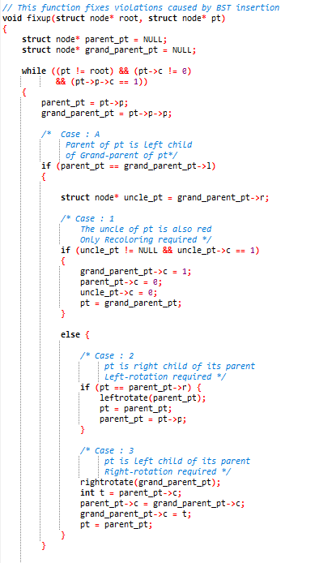
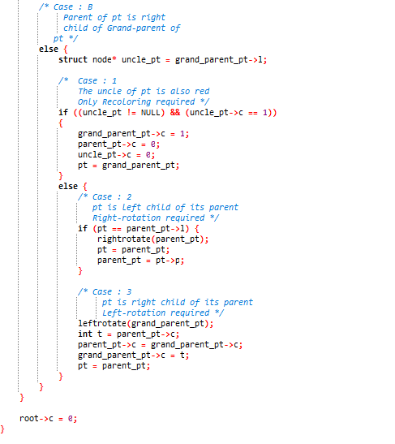
INTERNET CODE

Slide 163
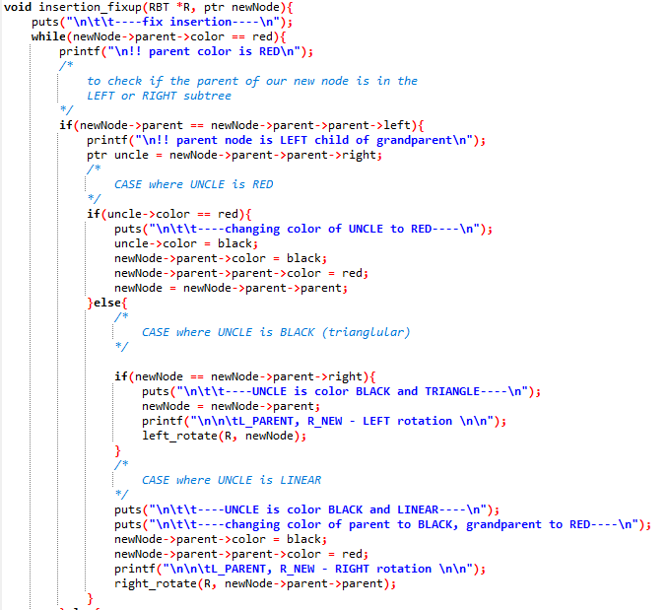
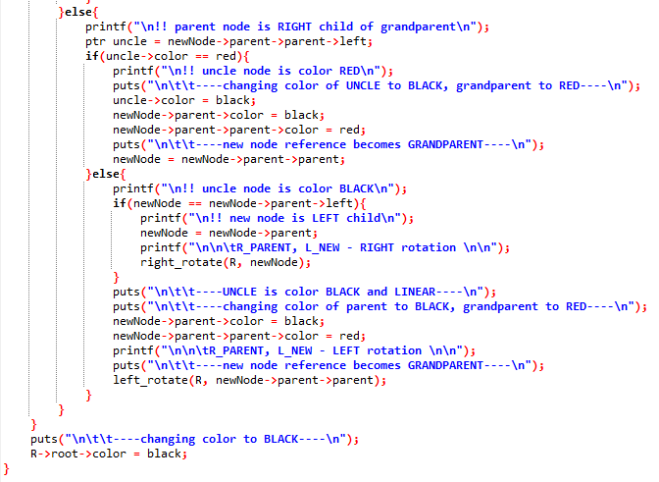
STREAMLINE CODE

Slide 164
THANK YOU

